Slide 1
Episodic drivers of Bering Sea crab populations
Cody Szuwalski
January 2025
Anchorage, AK

Slide 2
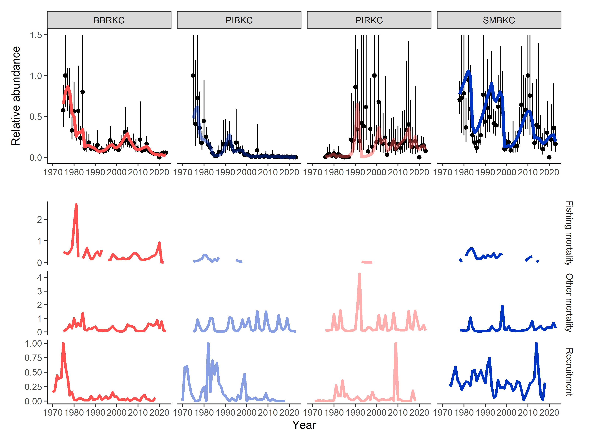
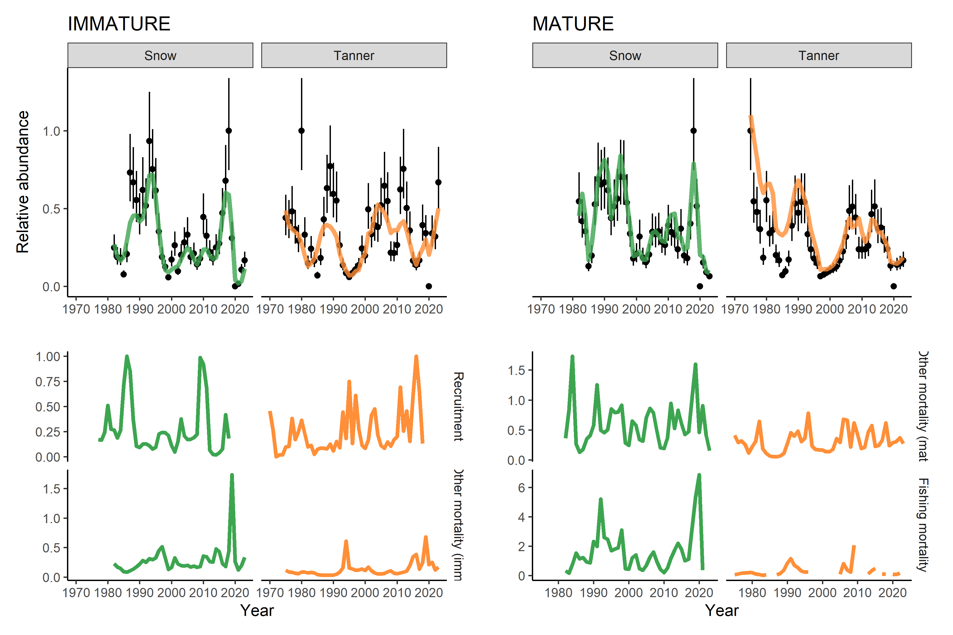
Problem
Highly variable population dynamics
Potential for unobserved mortality in non-directed fisheries
Use of periods of elevated mortality in assessments
Directed fishing is assumed to be the key driver of dynamics in classical fisheries science…if that’s not the case, it might change how we think about management

Slide 3
Can we model variation in ‘other’ mortality?

Slide 4
Population dynamics
Size structured models in ADMB
Male only
Only directed fishery incorporated
Estimate time-varying:
Recruitment
Directed fishing mortality
“Other” mortality
Predation, starvation, disease, senescence
Non-directed bycatch
Estimate invariant:
Probability of maturing (King crab)
Total and retained fishery selectivity
Survey selectivity (informed by BSFRF data)
Stock | Sizes | Prior on ‘other mortality’ | Year range
Snow crab | 30-135 | 0.27 | 1982-2023
Tanner crab | 25-185 | 0.27 | 1975-2023
BBRKC | 45-170 | 0.18 | 1975-2023
PIRKC | 45-220 | 0.18 | 1976-2023
SMBKC | 45-170 | 0.18 | 1978-2023
PIBKC | 45-200 | 0.18 | 1975-2023

Slide 5
Population dynamics
Time-varying mortality estimation
Estimate mean with prior
Estimate a dev_vector around mean
Add penalty on yearly estimate from mean for stability (similar to a random effect’s variance, but not estimated)
Possibility for a smoothness penalty on time series for stability
Stock | Sizes | Prior on ‘other mortality’ | Year range
Snow crab | 30-135 | 0.27 | 1982-2023
Tanner crab | 25-185 | 0.27 | 1975-2023
BBRKC | 45-170 | 0.18 | 1975-2023
PIRKC | 45-220 | 0.18 | 1976-2023
SMBKC | 45-170 | 0.18 | 1978-2023
PIBKC | 45-200 | 0.18 | 1975-2023

Slide 6
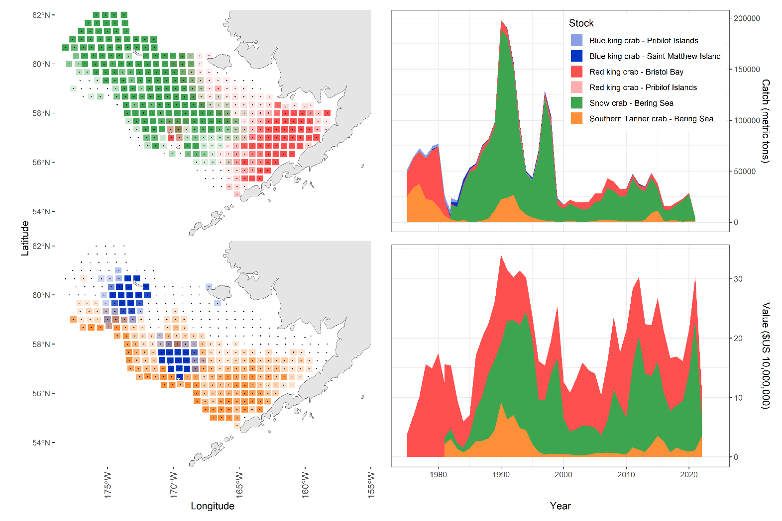

Slide 7
What are these models?
A framework to ask ecologically relevant questions like:
Can we assign episodes of volatility to directed fishing, recruitment, or ‘other’ mortality?
Are there relationship among processes within and/or among species?
Can we identify environmental covariates that explain variance in estimated processes?
How well can these processes be estimated under different circumstances (simulation)?

Slide 8
What are these models not?
A replacement for GMACS
Designed to provide management advice
Definitive estimates of other mortality
Time-variation in mortality can alias for other processes like selectivity or growth

Slide 9
Output
PRELIMINARY

Slide 10
Output
PRELIMINARY

Slide 11
CPT requests
Assessment authors:
Look at code to check data and assumptions like:
Input data
Timing of fishery
Prior on other mortality
Lag of recruitment
Size transition matrices + molting probabilities
Thoughts on if the estimated time series are ‘true’, how this changes your approach to management?
How does one manage a stock that doesn’t display a SR curve and has strong episodic drivers of both mortality and recruitment?
Inviting the CPT and assessment authors to be coauthors

Slide 12
Can we model variation in ‘other’ mortality?
MAYBE (now what?)

Slide 13
Tell the story of our stocks Is current management appropriate?

Slide 14
What happened?
Are collapses linked to recruitment or mortality?
Did ‘it’ happen to other stocks too?
Does recruitment covary across stocks?
Why did it happen?
Can we use environmental or population processes to explain variability over time?
What’s happens next?
How might warming impact the stocks?

Slide 15
What happened?
For example:
“XX% of decreases in abundance >XX% relative to the historical average were a result of mortality/recruitment”
“The collapse of Bristol Bay red king crab in the early 1980s was a confluence of unfortunate events, some controllable by management, others not. Recruitment collapsed in 1978, exceptionally high fishing mortality occurred in 1980 and 1981, and ‘other mortality’ was elevated from 1978-1984.”
When we saw a large YOY decline or increase, was that related to recruitment, fishing, or other mortality?
PRELIMINARY

Slide 16
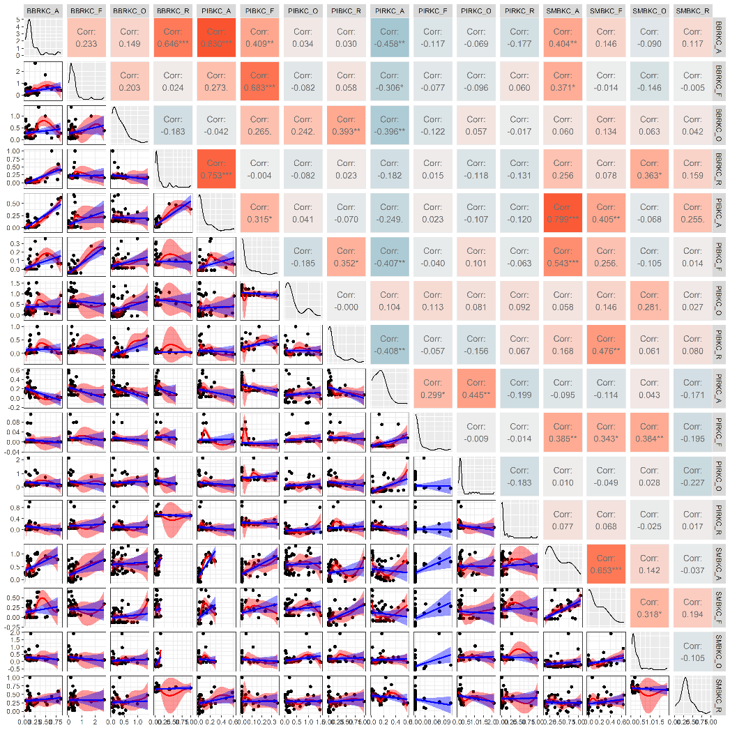
Did ‘it’ happen to other stocks?
Calculate correlations between population processes
Examples for king crab:
Large positive correlations
BBRKC total abundance + recruits
PIBKC + BBRKC + SMBKC abundance
BBRKC recruits + PIBKC abundance
SMBKC + PIBKC abundance
PIRKC other mortality + abundance
Large negative correlations
PIBKC recruits + PIRKC abundance
PIRKC + BBRKC abundance

Slide 17
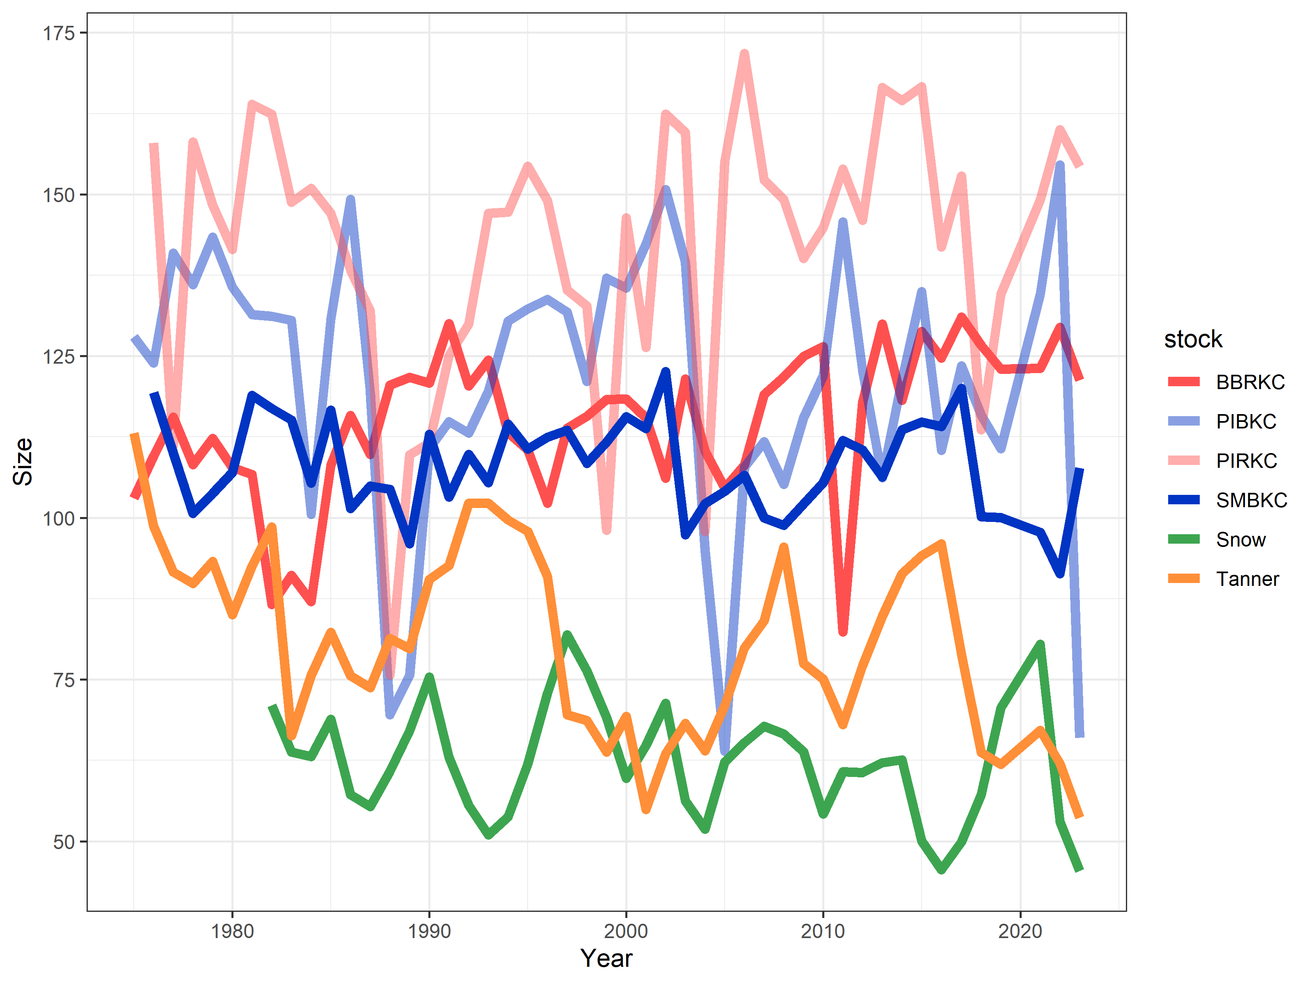
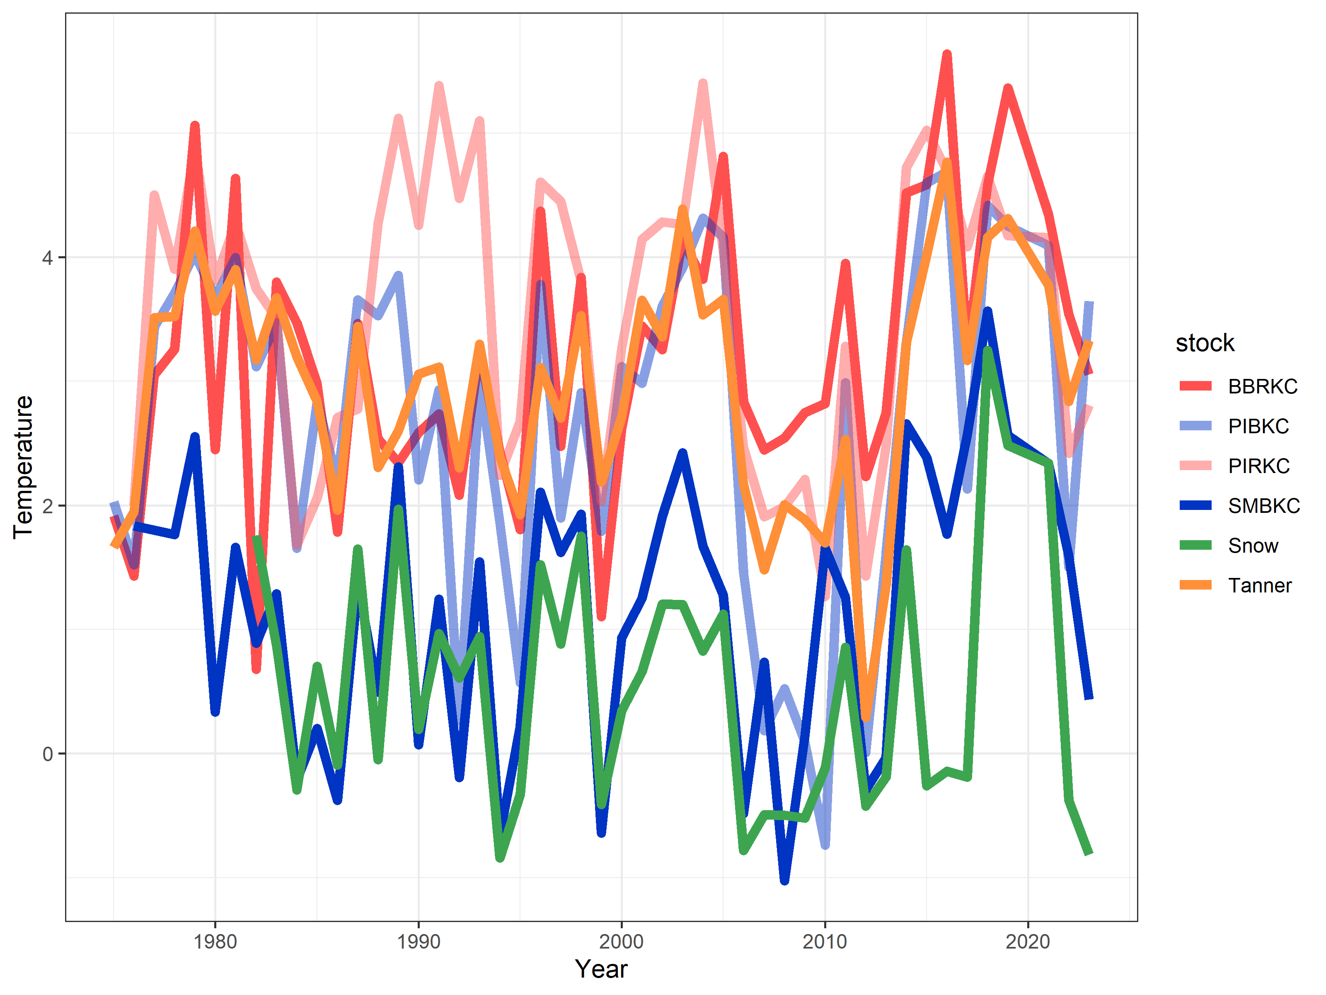
Why did ‘it’ happen?
Build models to explain variability in processes
Example models:
Recruitment ~ s(Abundance) + s(Temp) + s(Size)
(+ competitor in PIs?)
Mortality ~ s(Abundance) + s(Temp) + s(Size)
Temperature occupied = cpue weighted bottom temperature
Size = cpue weighted average size
(insert other covariates here…perhaps from ESP)

Slide 18
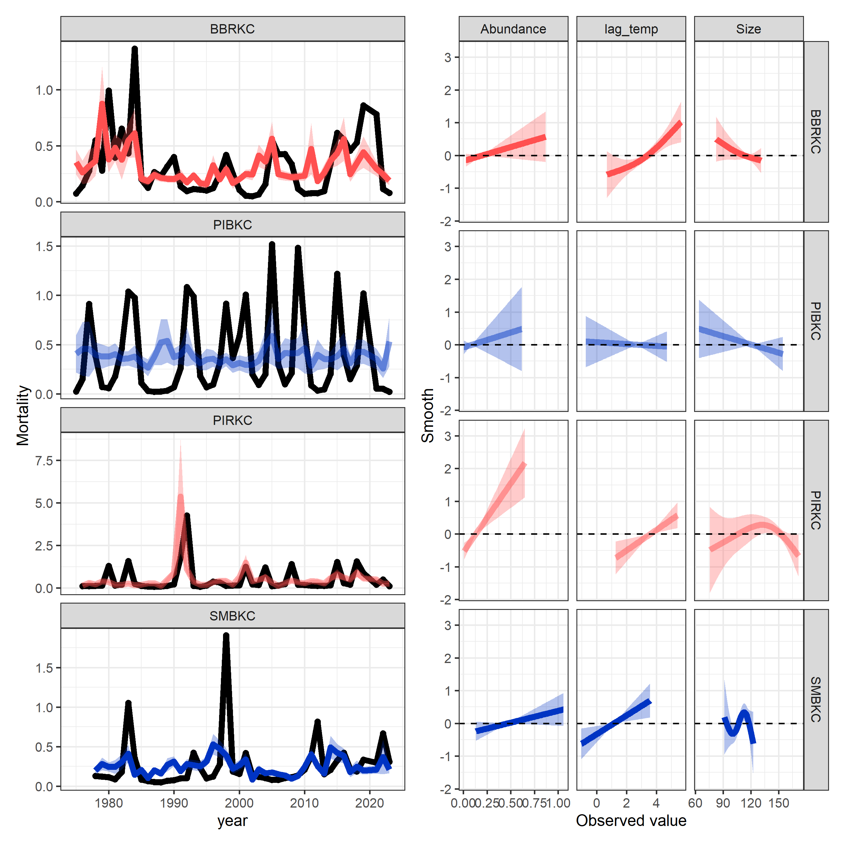
Why did ‘it’ happen?
Build models to explain variability in processes
Example models:
Recruitment ~ s(Abundance) + s(Temp) + s(Size)
Mortality ~ s(Abundance) + s(Temp) + s(Size)
Temperature occupied = cpue weighted bottom temperature
Size = cpue weighted average size
(insert other covariates here…perhaps from ESP)
PRELIMINARY

Slide 19
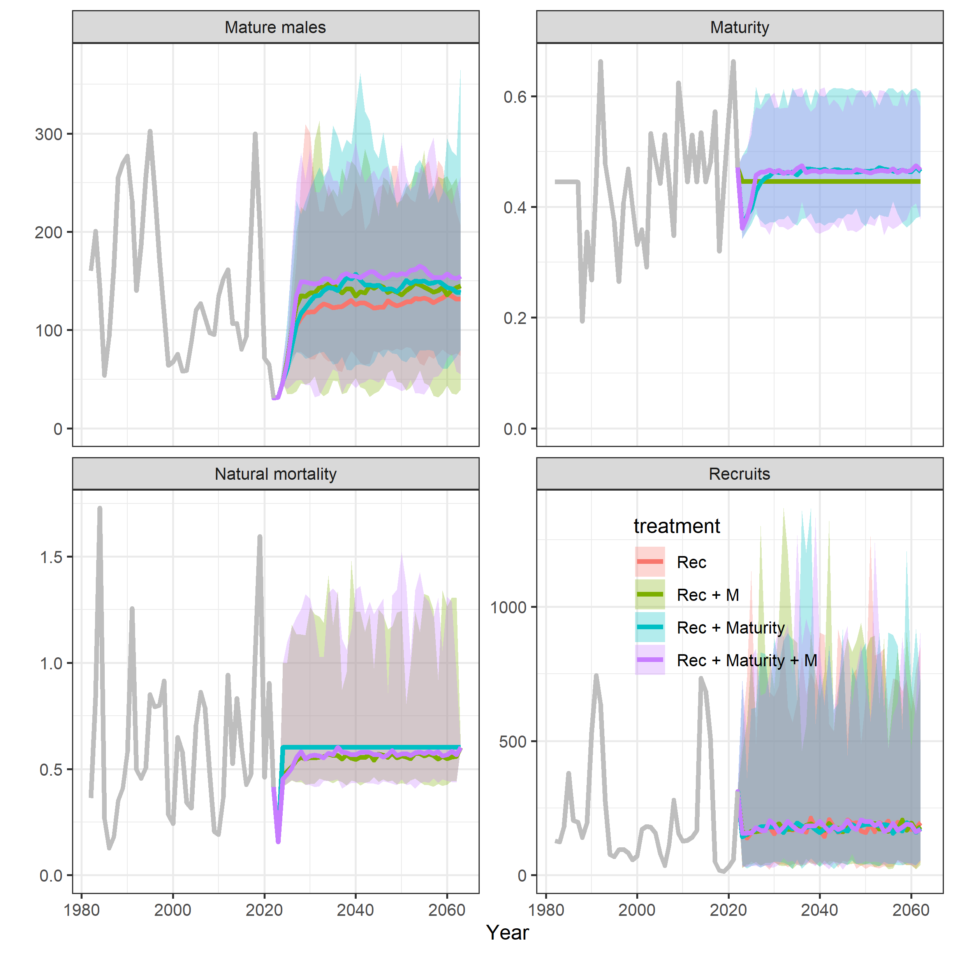
What happens next?
Project forward under climate and fishing scenarios
Snow crab:
Historical environmental conditions vs. warming
Where to incorporate uncertainty?
Estimated assessment parameters
Estimated relationships to environmental parameters
Projections of important variables
What is needed to place confidence in a given projections?

Slide 20
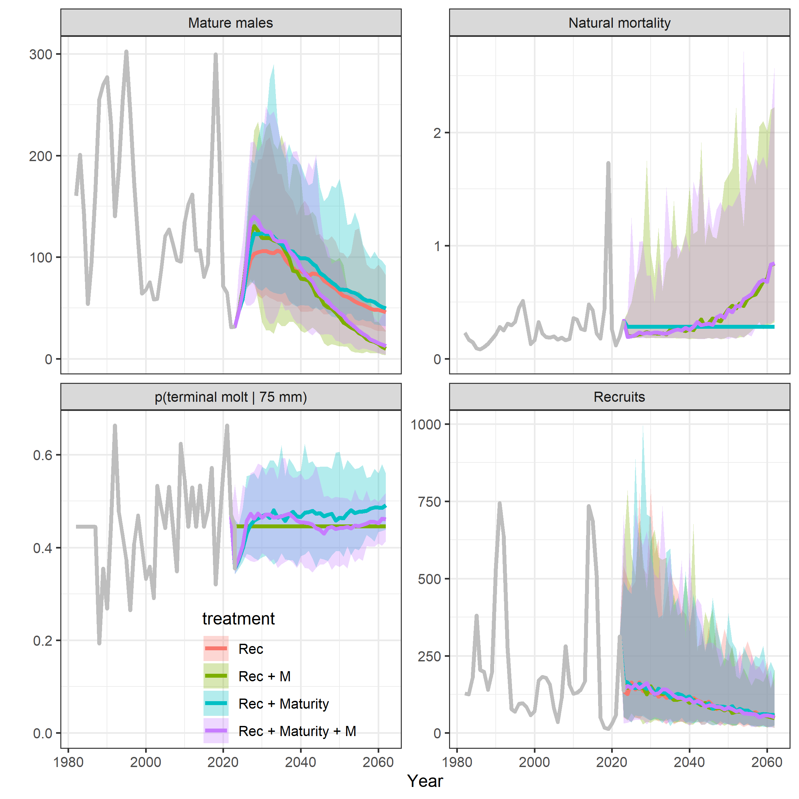
What happens next?
Project forward under climate and fishing scenarios
Snow crab:
Historical environmental conditions vs. warming
Where to incorporate uncertainty?
Estimated assessment parameters
Estimated relationships to environmental parameters
Projections of important variables
What is needed to place confidence in a given projections?

Slide 21
Arguments against
Mortality can alias for variability in other processes
Time varying mortality makes reference point calculation harder
Uncertainty compounds
Any others?

Slide 22
CPT requests
Assessment authors:
Look at code to check data and assumptions like:
Input data
Timing of fishery
Prior on other mortality
Lag of recruitment
Size transition matrices + molting probabilities
Thoughts on if the estimated time series are ‘true’, how this changes your approach to management?
How does one manage a stock that doesn’t display a SR curve and has strong episodic drivers of both mortality and recruitment?
Inviting the CPT and assessment authors to be coauthors

Slide 23
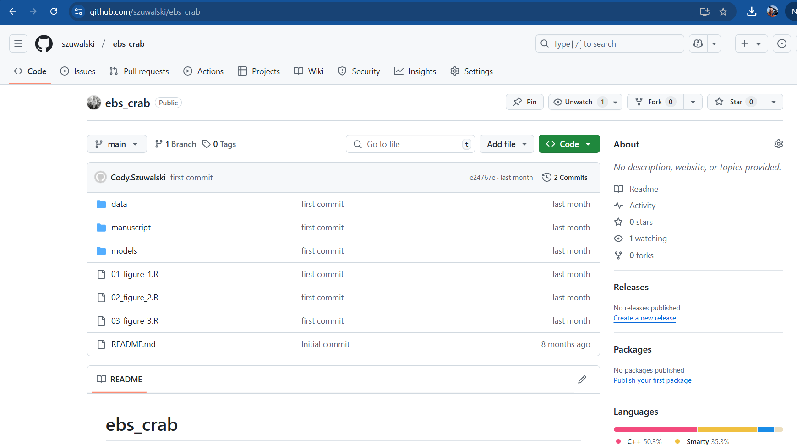

Slide 24
Things to add
Fits of stock recruit curves
Implied stock recruit curves for current reference points
Fit the models with constant ‘other mortality’ for comparison
(other analyses of interest?)

Slide 25
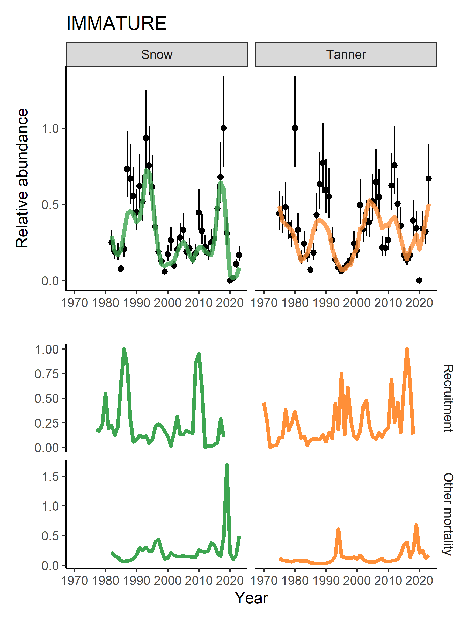
Immature mortality for snow and Tanner highly correlated with 2019 being highest for both stocks BUT
Highest temperatures for Tanner crab were during the blob, not the 2018-2019 marine heatwave (though still high).
Why did both Tanner and snow crab experience high mortality during 2019 heatwave?

Slide 26
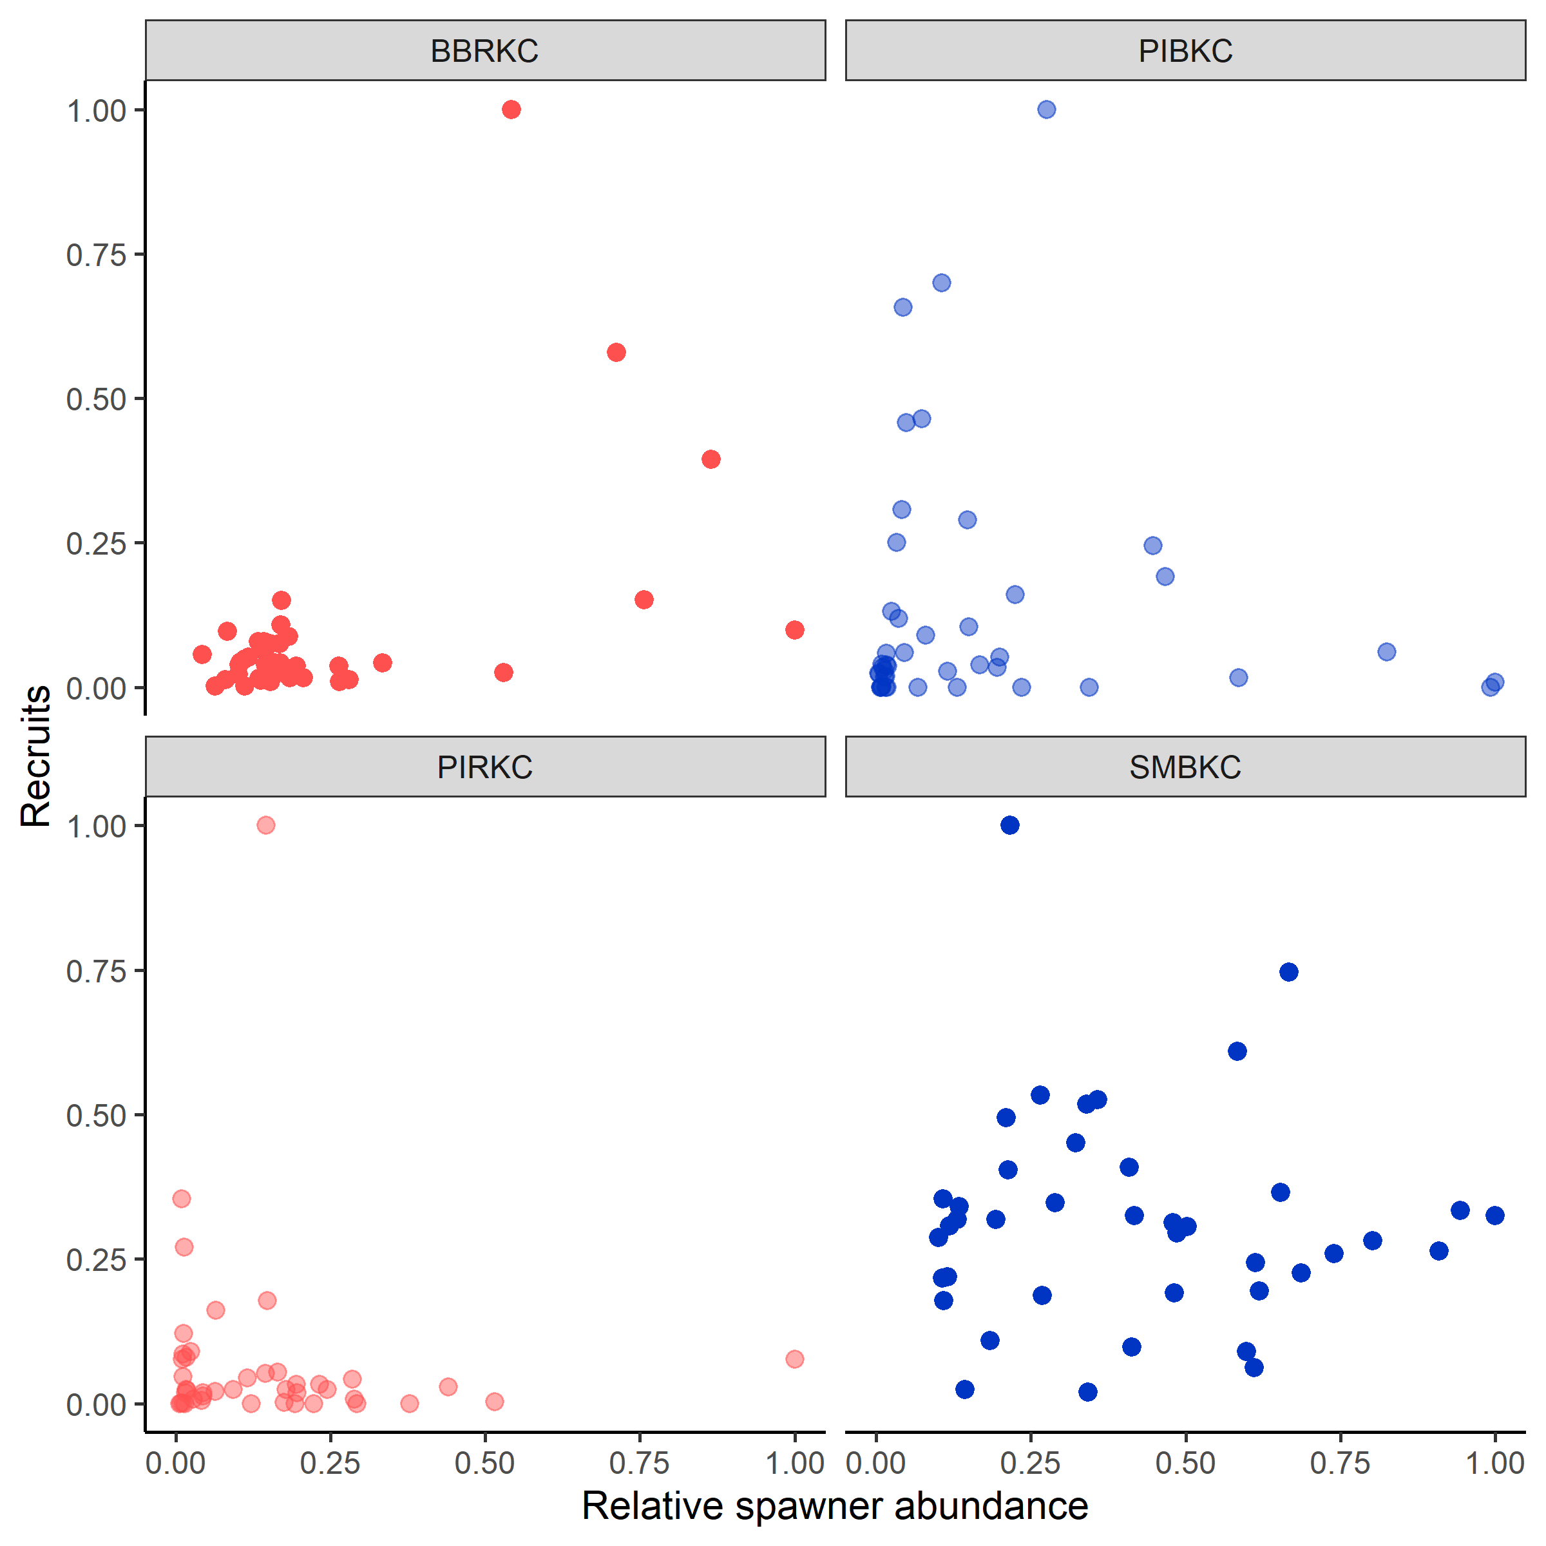
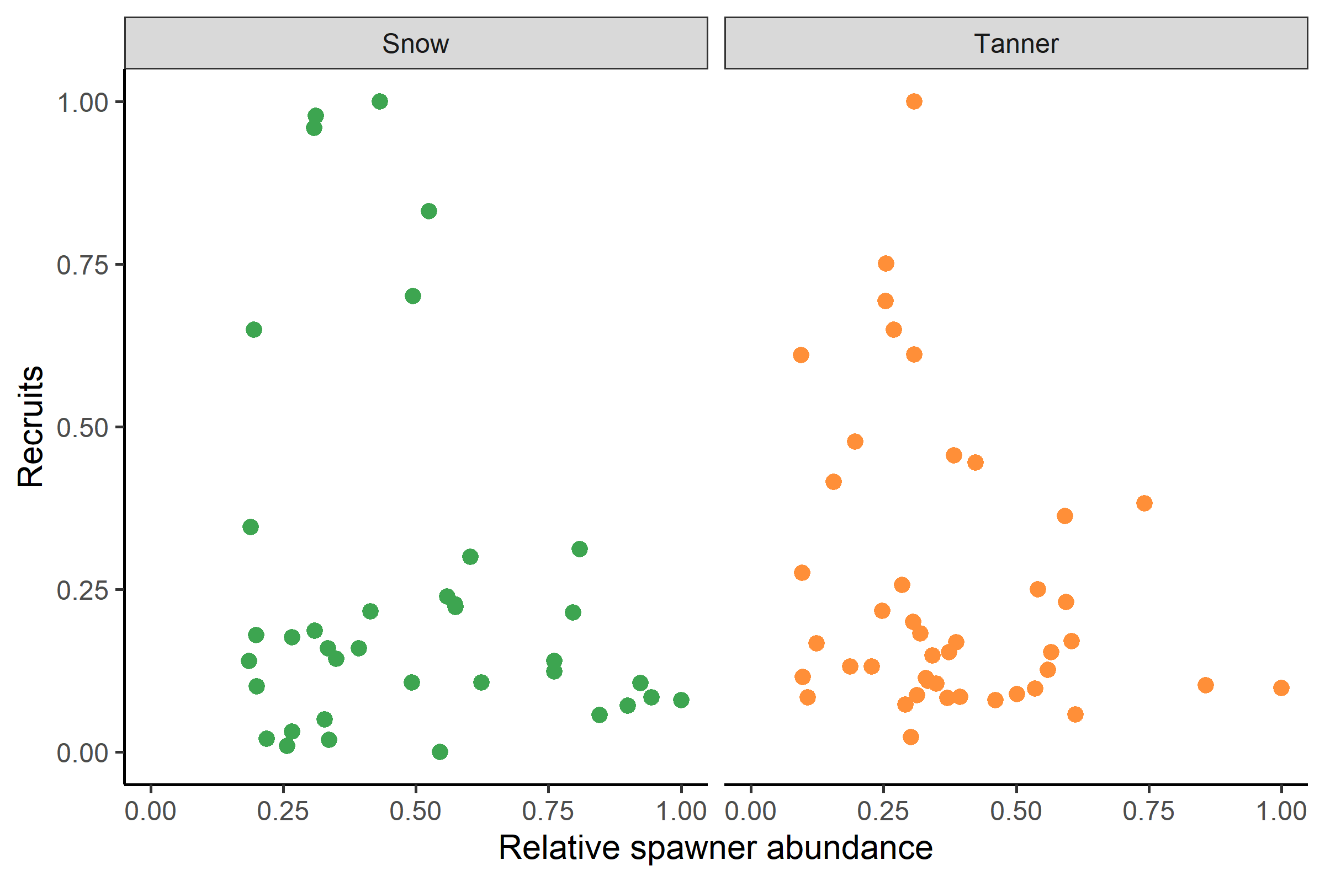
Stock recruit relationships

Slide 27
